Slide 1
ANTIMICROBIAL DRUGS

Slide 2
Introduction
A chemotherapeutic agent is a chemical that combats disease in the body.
An antimicrobial drug is a chemical substance that destroys disease-causing microorganisms with minimal damage to host tissues.
Antimicrobial drugs may be synthetic drugs (prepared in the laboratory) or antibiotics (produces by bacteria or fungi).

Slide 3
Historical Development
The first chemotherapeutic agent, discovered by Paul Ehrlich, was salvarsan, used to treat syphilis.
Sulfa drugs came into prominence in the late 1930s.
Alexander Fleming discovered the first antibiotic, penicillin, in 1929; its first clinical trials were done in 1940.
Antibiotics are produced by species of Streptomyces, Bacillus, Penicillium, and Cephalosporium.

Slide 4
Representative Sources of Antibiotics
MICROORGANISM | ANTIBIOTIC
Gram Positive Rods
Bacillus subtilis Bacillus polymyxa | Bacitracin polymyxin
Actinomycetes
Streptomyces nodosus Streptomyces venezuelae Streptomyces aureofaciens Streptomyces erythraeus Streptomyces fradiae Streptomyces noursei Streptomyces griseus | Amphotericin B Chloramphenicol Chlortetracycline (Aureomycin) and tetracycline Erythromycin Neomycin Nystatin Streptomycin
Fungi
Cephalosporium Penicillium griseofulvum Penicillium notatum | Cephalothin Griseofulvin Penicillin

Slide 5
Criteria for Evaluating Antimicrobial Drugs
The drug should demonstrate selective toxicity. This means that, at the optimum concentration, the drug should be toxic for the microorganism but not for the host. In practice, some toxicity or side-effects are often considered acceptable.
The drug should not produce hypersensitivity (allergy) in most hosts. Allergic reactions, which are produced by the immune system, are not the same as toxicity. Penicillin, for example, sometimes causes allergic reactions but is one of the least toxic antibiotics for humans.

Slide 6
3. A drug must be soluble in body fluids so that it can rapidly penetrate body tissues.
The rates at which the drug is broken down and excreted from the body must be low enough that the drug remains in the infected body tissue long enough to exert its effects. Certain antibiotics are especially valuable because they penetrate into the brain. Other drugs penetrate into bacteria-containing macrophages, concentrate in the urine, or have similar advantages.
4. Microorganisms should not readily become resistant to the drug.

Slide 7
Spectrum of Activity
Antibacterial drugs affect many targets in a prokaryotic cell.
Fungal, protozoan, and helminthic infections are more difficult to treat because these organisms have eukaryotic cells.
Narrow spectrum drugs affect only a select group of microbes –gram-positive cells, for example.
Broad spectrum drugs affect a large number of microbes.
Antimicrobial agents should not cause excessive harm to the normal flora.
Superinfections occur when a pathogen develops resistance to the drug being used or when normally resistant flora multiply excessively, like the excessive growth of Candida albicans .

Slide 8
Action of Antimicrobial Drugs
General action is either by directly killing microorganisms (bactericidal) or by inhibition of growth (bacteriostatic).
Some agents, such as penicillin, inhibit cell wall synthesis in bacteria.
Other agents, such as chloramphenicol, erythromycin, tetracyclines, and streptomycin, inhibit protein synthesis by acting on 70S ribosomes.
Agents such as polymyxin B, cause injury to plasma membranes.
Rifamycin, nalidixic acid, and trimethoprim inhibit nucleic acid synthesis.
Agents such as sulfanilamide act as antimetabolites by competitively inhibiting enzyme activity.

Slide 9
Figure 20.2

Slide 10
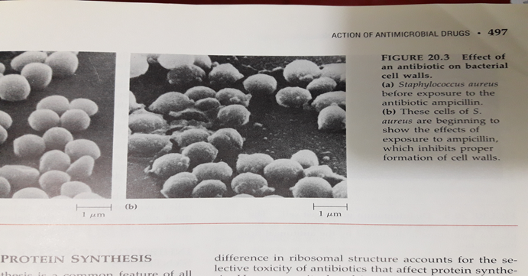
Modes of Action
Inhibition of cell wall synthesis= Penicillin and cephalosporine
Figure 20.3

Slide 11
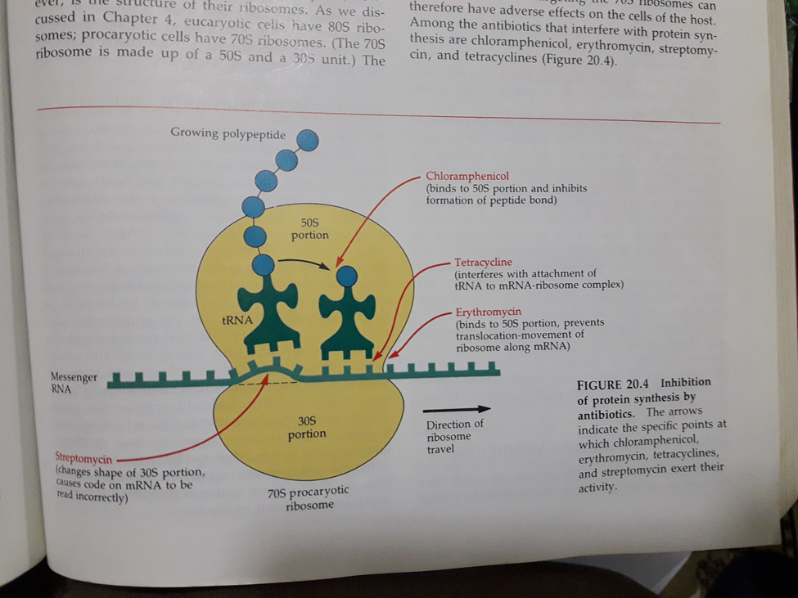
2. Inhibition of protein synthesis= chloramphenicol, erythromycin, streptomycin, and tetracyclines.

Slide 12
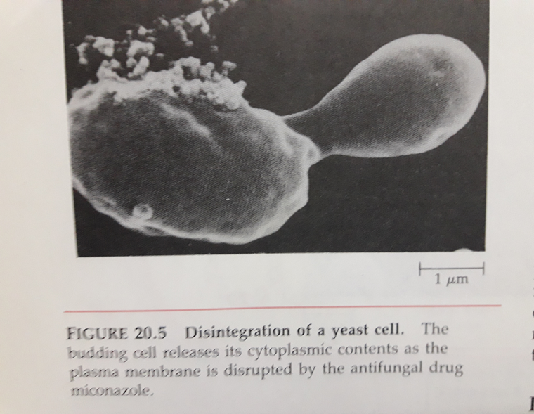
3. Injury to plasma membrane= polymyxin, nystatin, amphotericin B, and ketoconazole.
Figure 20.5

Slide 13
6. Inhibition of nucleic acid = rifamycin, nalidixic acid, and trimethoprim.
7. Inhibition of enzymatic activity= sulfa drugs like sulfones and trimethoprim

Slide 14
Inhibition of Enzymatic Activity
An example of competitive inhibition is the relationship between the antimetabolite sulfanilamide (a sulfa drug) and para-aminobenzoic acid (PABA). In many microorganisms, PABA is the substrate for an enzymatic reaction leading to the synthesis of folic acid, a vitamin that functions as a coenzyme for the synthesis of the purine and pyrimidine bases of nucleic acids. In the presence of sulfanilamide, the enzyme that normally converts PABA to folic acid combines with drug instead of with PABA.

Slide 16
Survey of Commonly Used Antimicrobial Drugs
Antibacterial Synthetics
Isoniazid (INH) inhibits mycolic acid synthesis in mycobacteria. INH is administered with rifampin or ethambutol to treat tuberculosis.
The antimetabolite ethambutol is used with other drugs to treat tuberculosis.
Sulfonamides competitively inhibit folic acid synthesis. Sulfonamides are bacteriostatic. They are used to treat urinary tract infections and can cause allergies and drug resistance.
Trimethoprim and sulfamethoxazole competitively inhibit dihydrofolic acid synthesis for treatment of urinary tract and intestinal infections.

Slide 17
5. Nitrofurans may break DNA molecules; they are used to treat urinary tract infections.
6. Nalidixic acid and quinolones interfere with DNA synthesis; they are used to treat infections caused by gram-negative bacteria.
7. Quinolones inhibit DNA gyrase for treatment of urinary tract infections.
Gyrase=enzyme used by bacteria to coil DNA into the double helical form.
8. The antifungal agent flucytosine is an antimetabolite of cytosine.

Slide 18
B. Antibiotics
Penicillins have low toxicity. They inhibit peptidoglycan synthesis; cell death is by osmotic lysis.
Penicillin G and V are natural penicillins and are effective against gram positive cocci and spirochetes.
Several semisynthetic penicillins such as ampicillin are resistant to stomach acid and penicillinases and are broad spectrum.
Ureidopenicillins such as mezocillin are effective against Pseudomonas spp.
Cephalosporins inhibit cell wall synthesis and are used against penicillin-resistant strains.

Slide 19
6. Carbapenems are broad spectrum antibiotics that inhibit cell wall synthesis.
7. Aminoglycosides include streptomycin, neomycin, spectinomycin, and gentamycin; all inhibit protein synthesis and are bactericidal.
8. Tetracyclines inhibit protein synthesis and are bacteriostatic toward many bacteria, including rickettsias and chlamydias.
9. Chloramphenicol inhibits protein synthesis and bacteriostatic; a side-effect of prolonged use is aplastic anemia.
10. Macrolides, such as erythromycin, inhibit protein synthesis and are bacteriostatic; erythromycin is used to treat legionellosis and Neisseria infections.

Slide 20
11. Polypeptides include bacitracin and polymyxin B. They are applied topically to treat superficial infections.
12. Bacitracin inhibits cell wall synthesis primerly in gram-positive bacteria.
13. Polymyxin B damages plasma membranes and is effective against gram-negative bacteria.
14. Vancomycin inhibits cell wall synthesis and may be used to kill penicillinase-producing staphylococci.
15. Rifamycins are bactericidal and are especially effective against gram-positive bacteria, including mycobacteria.

Slide 21
ANTIFUNGAL DRUGS
Polynese, such as nystatin and amphotericin B, combine with plasma membrane sterols and are fungicidal.
Imidazoles interfere with sterol synthesis and are used to treat cutaneous and systemic mycosis. (clotrimazole, miconazole, and ketoconazole).
Griseofulvin interferes with eucaryotic cell division and used primarily to treat skin infections caused by fungi.
Other antifungal drugs like Tolnaftate is a common alternative to miconazole as a topical agent for the treatment of athlete’s foot. Its mechanism of action is not known.

Slide 22
ANTIVIRAL DRUGS
Amandine blocks penetration or uncoating of influenza A virus.
Purine and pyrimidine analogs include ribavirin, acyclovir, ganciclovirm azidothymidine (AZT), idoxuridine, trifluridine, vidarabine.
Interferon inhibits cell infection by viruses.

Slide 23
Figure 20.20

Slide 24
TESTS FOR MICROBIAL SUSCEPTIBILITY TO CHEMOTHEARAPEUTIC AGENTS
These tests are used to determine the degre of susceptibility of different microorganisms to chemothrapeutic agents.
They help to determine which chemotherapeutic agent is most likely to combat a specific pathogen.
These tests are used when susceptibility cannot be predicted or when drug resistance arises.

Slide 25
A-Disk-diffusion method
In this test, also known as the Kirby-Bauer test, a bacterial culture is inoculated on an agar medium, and filter-paper disks impregnated with chemotherapeutic agents are overlayed on the culture.
After incubation, the absence of microbial growth around a disk is called a zone of inhibition.
The diameter of the zone of inhibition, when compared with a standardized reference table, is used to determine whether the organism is sensitive, intermediate, or resistant to the drug.

Slide 26
Figure 20.21

Slide 27
B- Broth Dilution Test
In the broth dilution test, the microorganism is grown in liquid media containing different concentrations of a chemotherapeutic agent.
The minimum inhibitory concentration (MIC) is the lowest concentration of chemotherapeutic agent capable of preventing microbial growth.
The lowest concentration of chemotherapeutic agent that kills bacteria is called the minimum bactericidal concentration (MBC).

Slide 28
Figure 20.22

Slide 29
EFFECTIVENES OF CHEMOTHERAPEUTIC AGENTS
A- Drug Resistance
Drug resistance refers to the ability of microorganism to resist the antimicrobial effects of a chemotherapeutic agent.
Resistance may be due to enzymatic destruction of a drug or cellular or metabolic changes at target areas.
Hereditary drug resistance is carried by plasmids called resistance (R) factors.
Resistance can be minimized by the discriminate use of drugs in appropriate concentrations and dosages.
Hereditary drug resistance is often carried by extra-chromosomal genetic elements called plasmids. Some plasmids, including those called resistance (R) factors can be transferred between bacterial cells in a population and between different but closely related bacterial populations.

Slide 30
B- Effects of Combinations of Drugs
1. Combinations of drugs may be used to minimize the development of resistant strains, to employ a synergistic effect, to provide therapy prior to diagnosis, and to use small concentrations of each drug to lessen toxicity.
2. Some combinations of drugs are synergistic—they are more effective when taken togather. (example: penicillin and streptomycin in treatment of endocarditis; damage to bacterial cell walls by penicillin makes it easier for sreptomycin to enter).
3. Some combinations of drugs are antagonistic– when taken togather, both drugs become less effective than when taken alone. (example: tetracycline interferes with the action of penicillin).
Generally combinations of antimicrobial drugs should be used for the following purposes:
To prevent or minimize the emergence of resistant strains.
To take advantage of the synergistic effect.
To provide optimal therapy in life-threating situations before a diagnosis can be establishes with certainty.
To lessen the toxicity of individual drugs by reducing the dosage of each in combination.

Slide 31
Thank You

